Slide 1
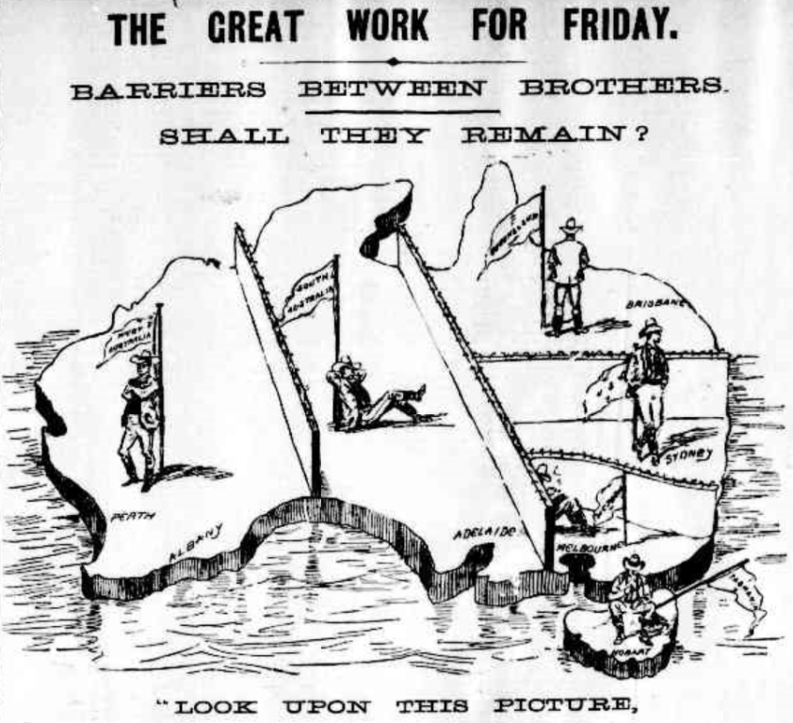
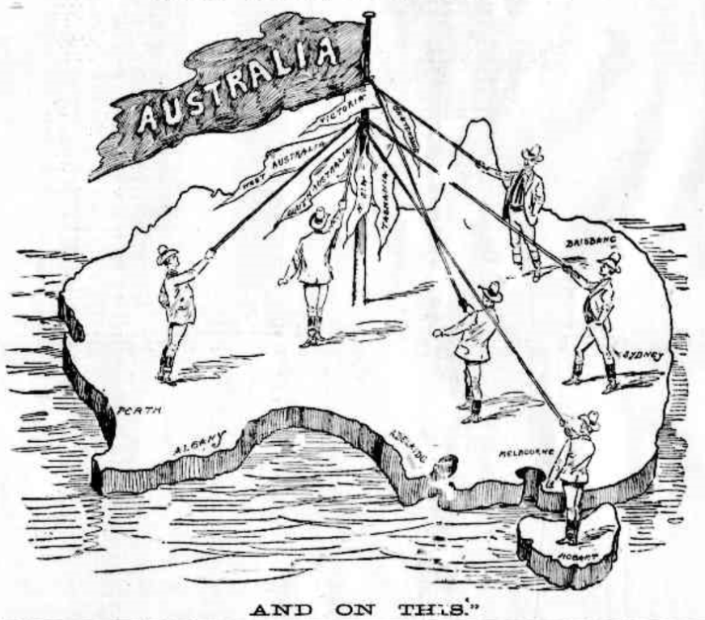
Identifying points of view in the past
The Argus (Melbourne),1 June 1898
Teacher Tip
Use slideshow mode.
Notes:
Let’s describe and interpret a cartoon from the past. Historians examine cartoons from the past to identify different points of view about issues and events in the past.

Slide 2
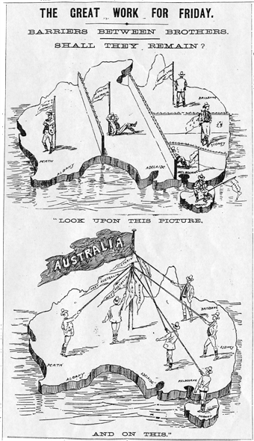
A cartoon from the past
A political cartoon is a historical source.
The cartoonist presents his/her point of view about an event, person or development at the time.
The Argus (Melbourne), 1 June, 1898
Notes:
It’s important to remember that political cartoons are historical sources that tell us about the past. The cartoonist presents his/her point of view about the events and issues of the time, that is, their current events and issues. We can see that this cartoon was published (Click) in the newspaper The Argus in 1898, so that means it was before Federation, which took place in 1901. Let’s interpret the visual and written language.

Slide 3
What was happening at that time?
The date of the cartoon is 1 June, 1898.
What was happening in the colonies at this time?
There were problems in the colonies and Federation was being considered as a solution.
Notes:
The date that the cartoon was published was 1st June, 1898. (Click) What was happening in the colonies at this time?
Towards the end of the 1800s, there were problems that were having effects on the colonies. (Click) There were:
social problems, such as the number of immigrants in the colonies and their ability to move freely between the colonies
economic problems, such as goods from other colonies being expensive due to tariffs imposed
political problems, such as slow communication between Britain and the colonies meaning that decisions took a long time to be enacted in the colonies.
With Henry Parkes’s support, the colonies began to talk about Federation and forming one nation.

Slide 4
Describing a cartoon
Describe the visual language features – the images and symbols.
Describe the written language features – the words or text.
The Argus (Melbourne), 1 June 1898
Notes:
There’s a lot happening in this cartoon so it helps to break it down into parts. (Click) Look at the images. That’s the visual language. (Click) … then look at the words or text. That’s the written language. Remember, a major step in interpreting a cartoon is to describe the visual and written language features.

Slide 5

What do you see in the top half?
Top half:
Map of Australia
Barriers/walls/fences
Six male figures next to a flag with each colony’s name
All the men are turned away from each other
Title is ‘Barriers between brothers — shall they remain?’
Caption below the image: ‘Look upon this picture.’
The Argus (Melbourne),1 June 1898
Notes:
What do you see in the top half of the cartoon?
(Click) In the top half, there’s a map of Australia.
(Click) On the map of Australia, there are barriers that look like walls or fences, dividing the six colonies.
(Click) There are six male figures — one in each colony — and they are each standing beside a flag, on which is written the name of the colony.
(Click) All the men are turned away from each other.
(Click) The image is titled, ‘Barriers between brothers — shall they remain?’
(Click) The caption below the image reads … ’Look upon this picture’.

Slide 6

What do you see in the bottom half?
Bottom half:
Map of Australia
One flag pole labelled ‘Australia’ with flags naming each colony beneath
Six male figures all facing the flag pole
Figures hold ropes linking them to the flag pole
Caption below the bottom image: ‘And on this.’
The Argus (Melbourne),1 June 1898
Notes:
What do you see in the bottom half of the cartoon?
(Click) There’s another map of Australia.
(Click) There is one flag pole labelled ‘Australia’ with the flags of all the colonies beneath.
(Click) Six male figures are facing the single flag pole.
(Click) All the figures hold ropes linking them to the flag pole.
(Click) The caption below the image reads, ‘And on this.’

Slide 7
Interpreting visual and written language
You need to think about what you see in the cartoon and relate it to the events happening at that time.
‘Interpret’ means ‘to explain the meaning’.
The Argus (Melbourne), 1 June 1898
Notes:
Let’s interpret the visual and written language. (Click) Remember, when we interpret, we try to explain the meaning or message of the cartoon. (Click) We do this by relating what we see in the cartoon to our knowledge about the events happening at that time. In this case, the cartoon was published in a Melbourne newspaper three days before a referendum was due to be held in Victoria on whether to become a Federated nation.

Slide 8
Interpreting visual and written language
The title refers to the barriers between the colonies and the question of whether they should federate.
The men are turned away because they don’t want to co-operate with the other colonies.
There are six men leaning on flagpoles flying flags showing the name of the colony.
The six flags with the names of the colonies still fly from the one flag pole, which suggests they still have their own identities but these are no longer obstacles.
The large flag with ‘Australia’ written on it means that there are no longer six divided colonies but one country with one purpose.
The six men are holding ropes linked to the pole, which means they are all still individual but linked by a common cause.
The six men are all now facing each other, suggesting they are all co-operating with one another.
The caption highlights what can be achieved if things change because of Federation.
The Argus (Melbourne), 1 June 1898
Notes:
Let’s look at the six men with flags. How can we interpret this? (Click) Each one represents a colony of Australia. (Click) We can see the men are turned away from each other. This can be interpreted as the men are isolated — they don’t want to know about the others.
The bottom half of the cartoon shows the same map but with one flag pole and one flag with Australia on it.
(Click) This can be interpreted to mean that there are no longer six divided colonies but one country with one purpose.
(Click) The six different flags of the colonies all fly now from the one flag pole. This means that the colonies all have their own identities but these separate identities are no longer obstacles.
(Click) The six men are all now facing each other, which can be interpreted to mean that they are all cooperating with one another.
(Click) The six men are holding ropes linked to the pole, which means they were all still individual but linked by a common cause.
(Click) How about the title — ‘Barriers between brothers, shall they remain?’
(Click) The word, ‘barriers’, reflects the walls or fences that we can see in the cartoon. If we have visual and written language telling us the same thing, it must be important to the meaning of the cartoon. The question asked in the title – ‘Shall the barriers remain?’ – clearly refers to the question of whether the colonies should federate.
(Click) Let’s look at the captions – “Look upon the picture” below the first image and then “and on this” below the second image.
(Click) The cartoonist is directing the reader’s attention to the common purpose that could be achieved if Federation were to occur.

Slide 9
What is the main idea of the cartoon?
What is the overall message that is being expressed?
The Argus (Melbourne), 1 June 1898
Notes:
So what’s the overall message or meaning that is expressed in the cartoon? What is the main idea?

Slide 10
The main idea
A united Australia is a better Australia.
The Argus (Melbourne), 1 June 1898
Notes:
(Click) The main idea is that a united Australia is a better Australia. This conclusion is backed up by the evidence in the cartoon. The fences or walls, the way the men are looking away from each other and the title and caption of the cartoon all suggest that there is a lack of communication and cooperation between the colonies, which is holding Australia back. All of this is reversed in the bottom half of the cartoon, which suggests that, by federating, the old colonial barriers could be removed to make a great nation. What do you think? Do you think there is a different main idea?

Slide 11
Identify the point of view
The Argus (Melbourne),1 June 1898
The cartoonist’s point of view is that Federation would be good for Australia, as it would remove the barriers to progress.
Notes:
The last step is to identify the point of view. We can get this from the main idea and from considering whether the cartoonist shows this idea as a positive or a negative. Do you think the cartoonist is showing Federation as a good or bad idea?
For example, (Click) the cartoonist’s point of view is that Federation will be good for Australia, as it will remove the barriers that are holding Australia back. The cartoon was likely used as a strategy to persuade the people of Victoria to vote in favour of Federation.

Slide 12
Attributions
‘The great work for Friday’ in The Argus (Melbourne), 1 June 1898, p.5, http://trove.nla.gov.au/ndp/del/page/310001

